Slide 1

Deep Learning Hype, Reality and Applications in Manufacturing

Slide 2

Who Am I?
My name is Adam Cook.
Studied Mechanical Engineering at Purdue University West Lafayette.
Chief Technical Officer of Alliedstrand in Chicago (we also have engineers in Dallas).
Chair of SME Chapter 112 (Northwest Indiana and Chicagoland). Check out sme112.org.
I work with embedded systems, robotics, automation systems and industrial software.
Contact my chapter at hello@sme112.org.

Slide 3
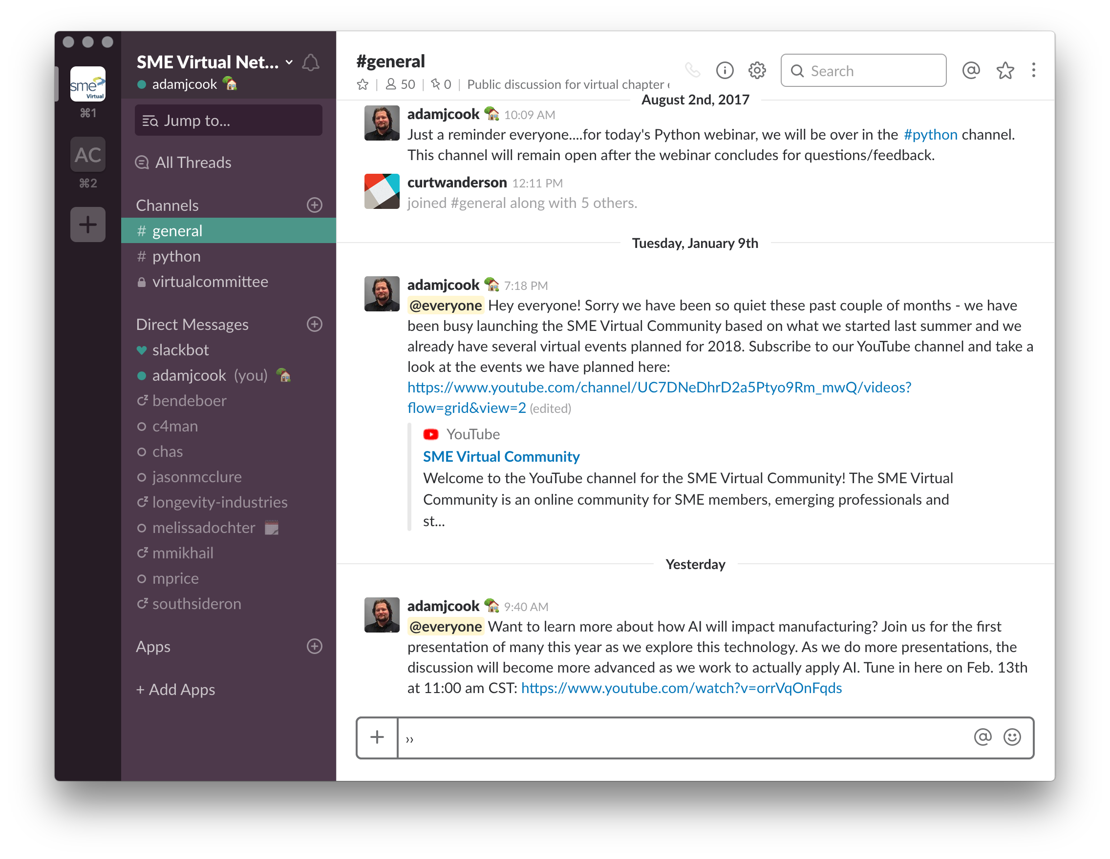

SME Virtual Network Slack
Are you an SME member? Do you want access to Slack? Fill out this short form: http://bit.ly/2BpjMiE

Slide 4
What is Artificial Intelligence (AI)?
Broadly, building machines that can perform tasks as a human could.
We are here today.
Narrow AI A system capable of achieving at least human parity in a few defined tasks that humans trained it to do.
Strong AI A system which is indistinguishable in intelligence from a human.

Slide 5
Scopes
Source http://bit.ly/2aoQwIx

Slide 6
Scopes
Artificial Intelligence (AI) Human intelligence exhibited by machines.
Machine Learning (ML) Machines that are capable of learning without being explicitly programmed.
Deep Learning (DL) Family of techniques to implement machine learning (e.g. deep neural networks or recurrent neural networks).
Source http://bit.ly/2aoQwIx

Slide 7
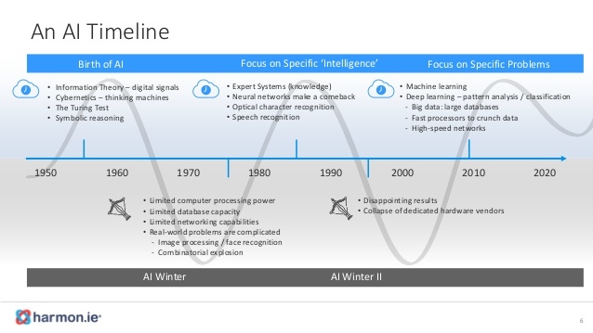
Winter Fun
History of AI Winters
Source http://bit.ly/2nOn8U8

Slide 8
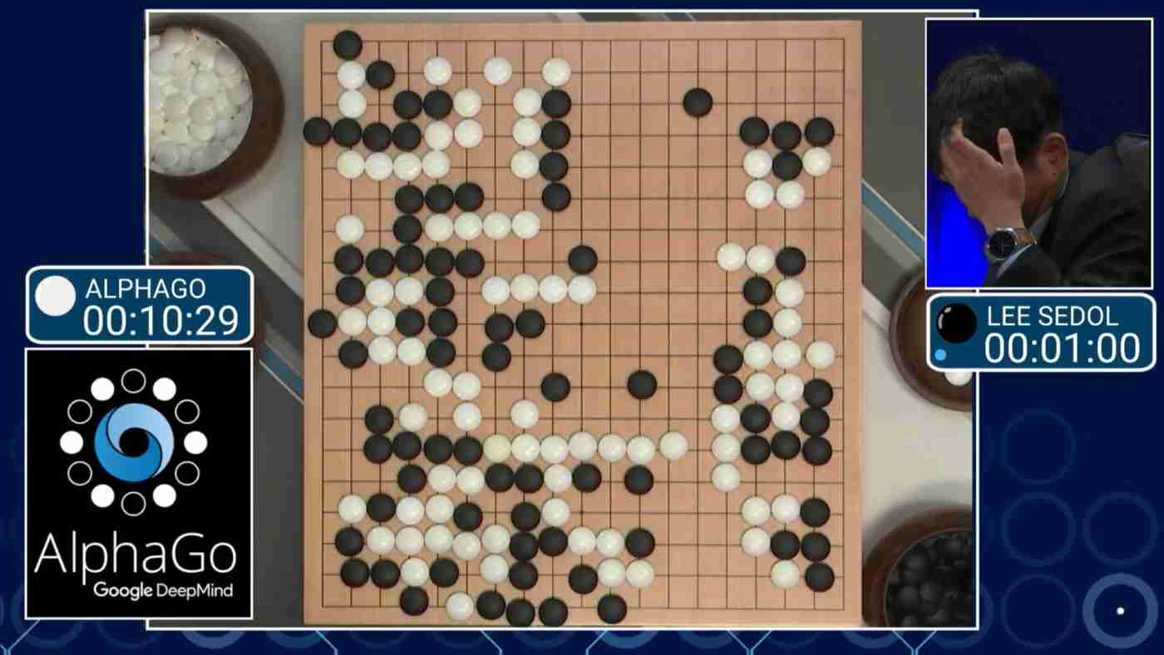
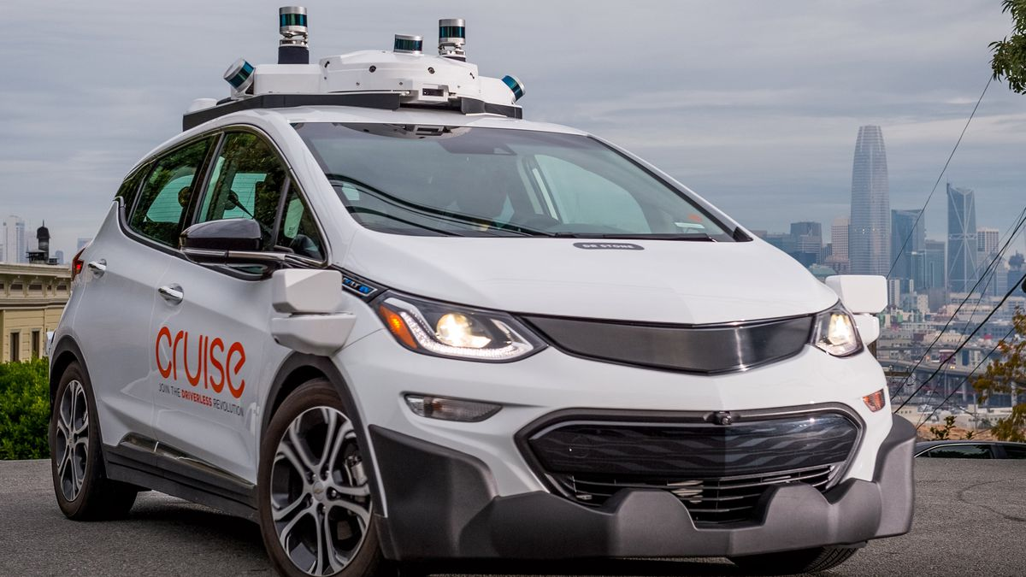
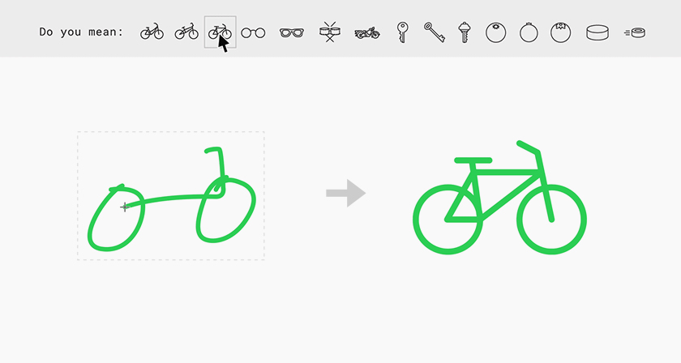
Recent Breakthroughs and Interesting Demos
AlphaGo Beats World’s Best Human Player
Self-driving Cars
Google AI Experiments

Slide 9
Is AI Here to Stay Now?
Simply, Yes.
Availability of large amounts of data.
Availability of large amounts of cost effective computing resources.
Particularly Graphical Processing Units (and some custom chip architectures)

Slide 10
But…
Winter can come again
(just maybe not as cold)

Slide 11
Where do you find AI today?
Natural Language Processing (NPL) Chatbots.
Image or Object Recognition Vision systems in autonomous vehicles.
Speech Processing/Translation Amazon Alexa or Google Home
Pattern Prediction After training the system, the system correctly predicts the output based on input it has not been trained on.

Slide 12
Predictions on AI (and some hype)
Various Predictions on Strong AI Horizon
http://bit.ly/2EqrUyh
Facebook AI System Went Rouge (total misrepresentation)
http://bit.ly/2uU4Un8
Robots Can Now Read, Millions of Jobs At Risk (not really)
http://bit.ly/2FEKMdO

Slide 13
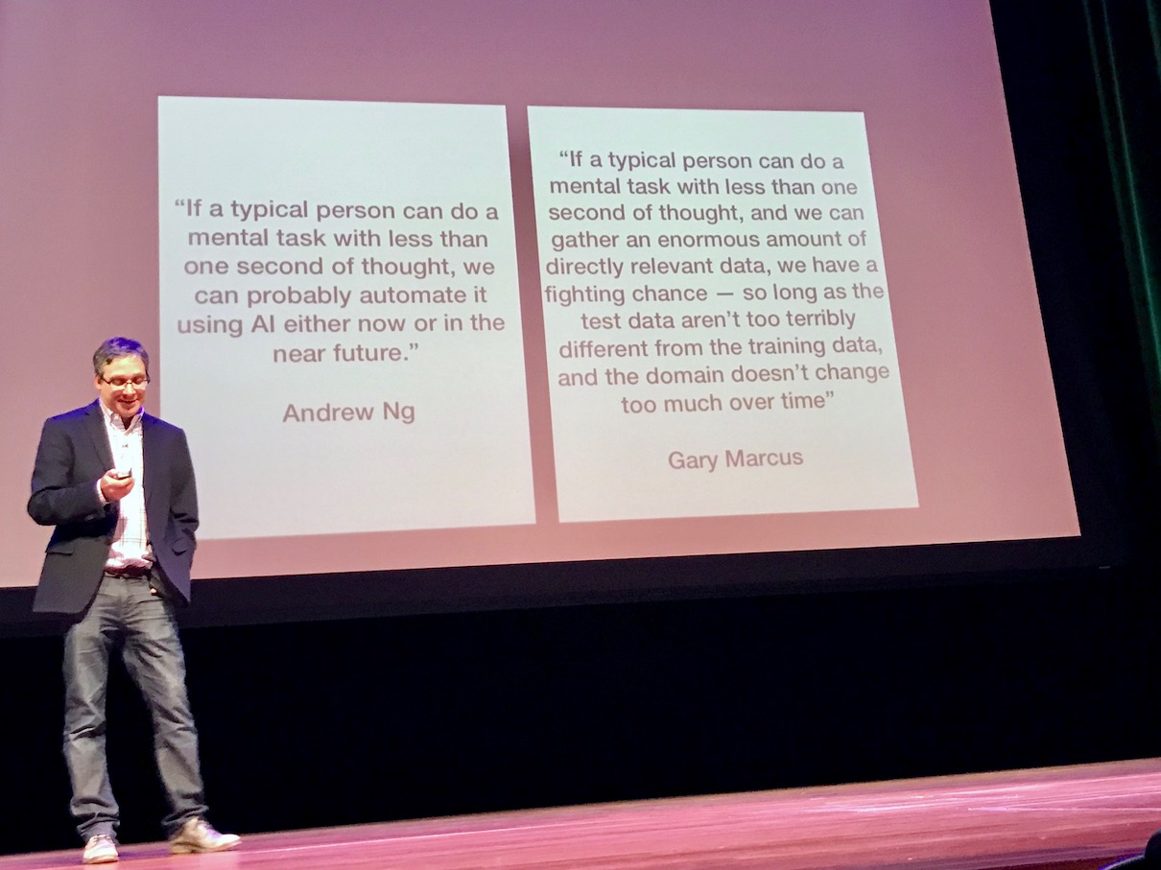
Predictions on AI (and some hype)
Source http://bit.ly/2nTcVok

Slide 14
My View on AI
Technology predictions which are multiple decades away are very suspect.
Tend to agree more with Rodney Brooks and Paul Allen than Ray Kurzweil on on the strong AI timelines.
AI coupled with automation (or robotics) will be transformational for manufacturing, but most of the time horizons quoted are too ambitious.
The knowledge requirements for many jobs will increase, but that is not 100% AI’s fault.
The public tends to look at an narrow AI system and, not understanding how it works, allows their imaginations to run wild.

Slide 15
Realist Optimistic View on AI
Dated Predictions from Rodney Brooks
http://bit.ly/2m8Xh8r

Slide 16
Machine Learning Basic Process
Step 1 Training
This is called Supervised Learning
Produces a predictive model
Training data set
Learning Algorithm (Network)
Contains sample input data and the correct output for that input data

Slide 17
Machine Learning Basic Process
Grouped by row in this case
(but it does not have to be)
Sample input data
(features or attributes)
Correct output data
(labels)

Slide 18
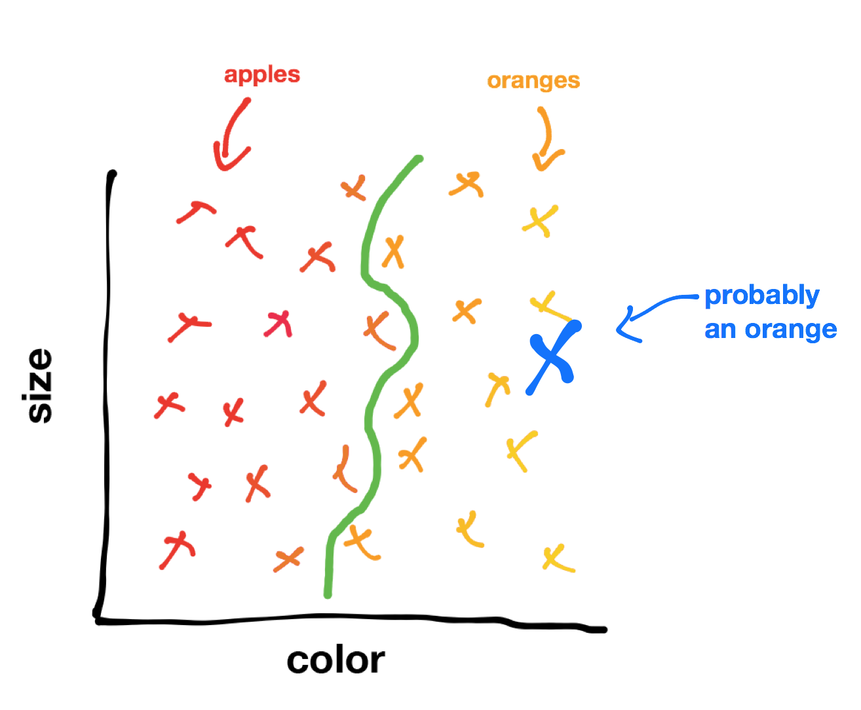
Two-Dimensional Training Data
Feature 1,1
Feature 1,2
Label for Feature 1,1 and Feature 1,2
Weight | Color | Fruit
 |  | Apple
 |  | Orange
 |  | Orange
 |  | Orange
 |  | Apple
 |  | Orange
 |  | Apple
 |  | Apple
Source http://bit.ly/2EB7JkC

Slide 19
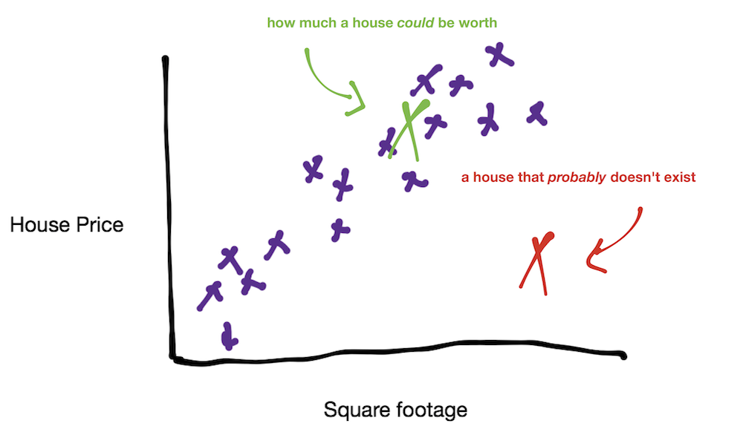
Regression (in 2D)
Feature 1,1
Feature 1,2
Price | Sq. Foot
Source http://bit.ly/2EB7JkC

Slide 20
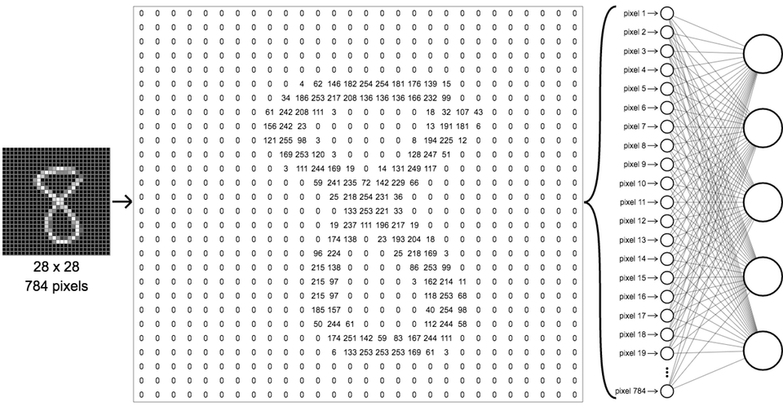
Handwritten Character Training Data
From MNIST dataset
Correct label for this data is 8.
Sample input data

Slide 21
Machine Learning Basic Process
Step 2 Prediction
Generated from Step 1
New Input Data
Predictive Model
Prediction
The learning system has potentially never seen this input data before.
Hopefully, this is correct.

Slide 22
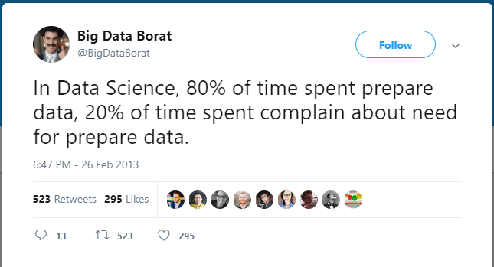
Training Data Considerations
Source http://bit.ly/2F19lSu

Slide 23
Training Data Considerations
Data can (and it will, at times) lie to you.
Think about data delivery – particularly if it is arriving from human sources (i.e. manual data collection on clipboard).
Data anomalies will occur (i.e. sensor failures). How do you address them?
Are you collecting the right data and, more importantly, enough relevant data? A determination must be made of what features are important and which are not in pursuit of an ML system.
Careful of biases (i.e. confirmation bias, selection bias and others) and anecdotal evidence. Be scientific!
When facts are weapons.
Good example of selection bias. Why?

Slide 24
Intermission
Questions? Ask in the Live Chat or check the feedback link in the description!
Or
Watch http://bit.ly/2ED471m

Slide 25
Learning Types
Supervised Learning ML system is trained with a labeled data set
Unsupervised Learning ML system is trained with an unlabeled data set
Reinforcement Learning ML system learns by trail-and-error combined with a reward (or punishment) system

Slide 26
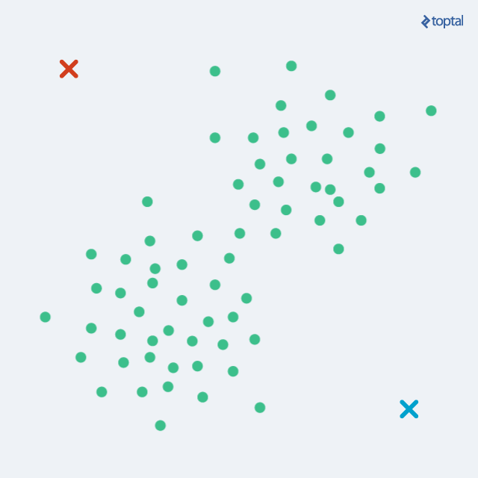
Unsupervised Learning - Clustering
Source http://bit.ly/298TWkp

Slide 27
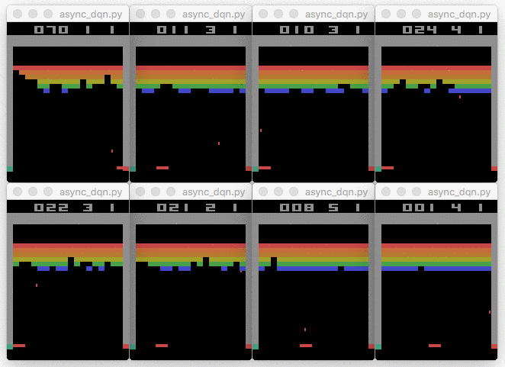
Reinforcement Learning
Environment
Reward (or Punishment)
Action
Agent
Source http://bit.ly/1UkaiYQ

Slide 28
Neural Network Basics
Great video on the basics of neural networks. Do not pass this one up!
http://bit.ly/2fMZljF

Slide 29
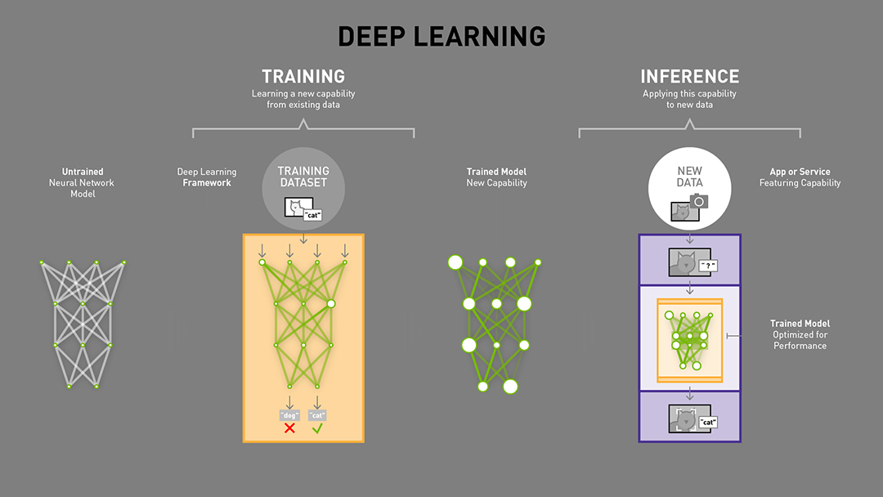
Neural Network Basics
Source http://bit.ly/1UkaiYQ

Slide 30



Neural Network Basics
b, Bias
w, Weight
These are tunable parameters during the training process.

Slide 31
Harsh Realities of AI
No out-of-the-box solutions for manufacturing (not yet, anyways).
Need data experts.
Need IT/OT expertise.
Adoption can be very expensive.
AI gets you that “last mile” of value, it is not magic.
Some progress to address the first two points for SMMs via Google’s Cloud AutoML product. Jury still out on its generality…

Slide 32
Manufacturing Applications in AI
Predictive equipment maintenance
Digital twin
Dynamic processing (micro)
Dynamic production (macro)
Automated visual inspection and decision making

Slide 33

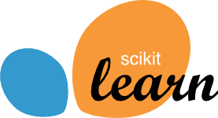
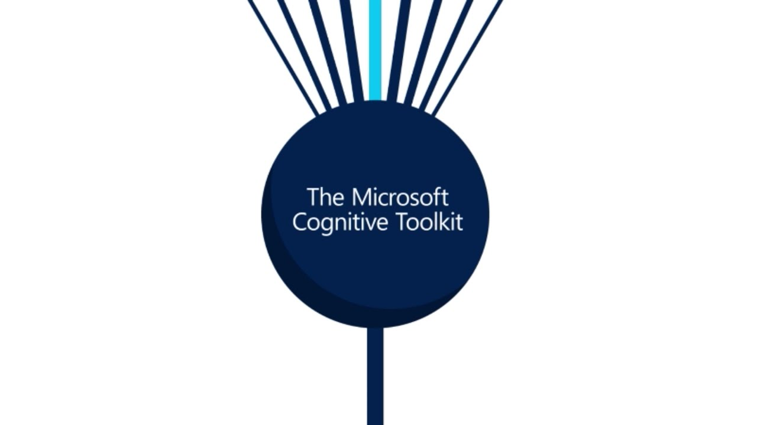
Popular ML Frameworks and Libraries

Slide 34
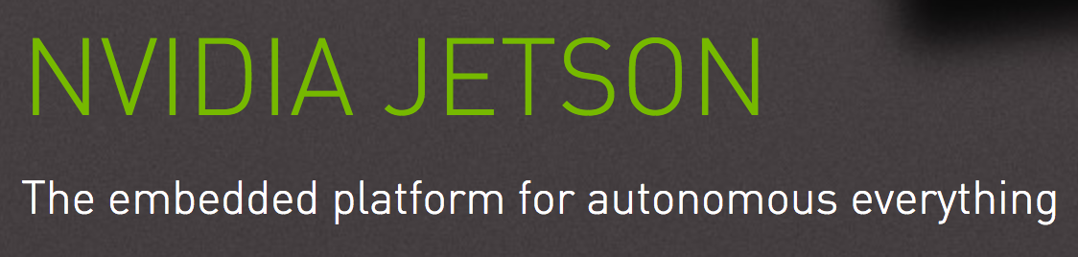



Some ML Hardware Options (for GPUs)

Slide 35
Continued Learning Resources
Machine Learning Course on Coursera
Practical Deep Learning for Coders
Udacity Machine Learning Nanodegree

Slide 36
Next webinars
Webinar March 6 at 11:00 am CST IIoT Fundamentals and Applications
3-Day Workshop Starts March 2 Python Fundamentals for Engineers and Manufacturers
Webinar March 21 at 11:00 am CST Setting Up Python on Your Computer
3-Day Workshop Starts March 28 Python Fundamentals for Engineers and Manufacturers
Webinar May 15 at 11:00 am CST Introduction to Machine Vision

Slide 37
Thank you!
Want to learn more about
?
Check out sme.org
Questions? Ask in the Live Chat or check the feedback link in the description!

